Slide 1
Data & Analytics and Machine Learning on AWS
Raheem Jiwani
07/02/2025

Slide 2
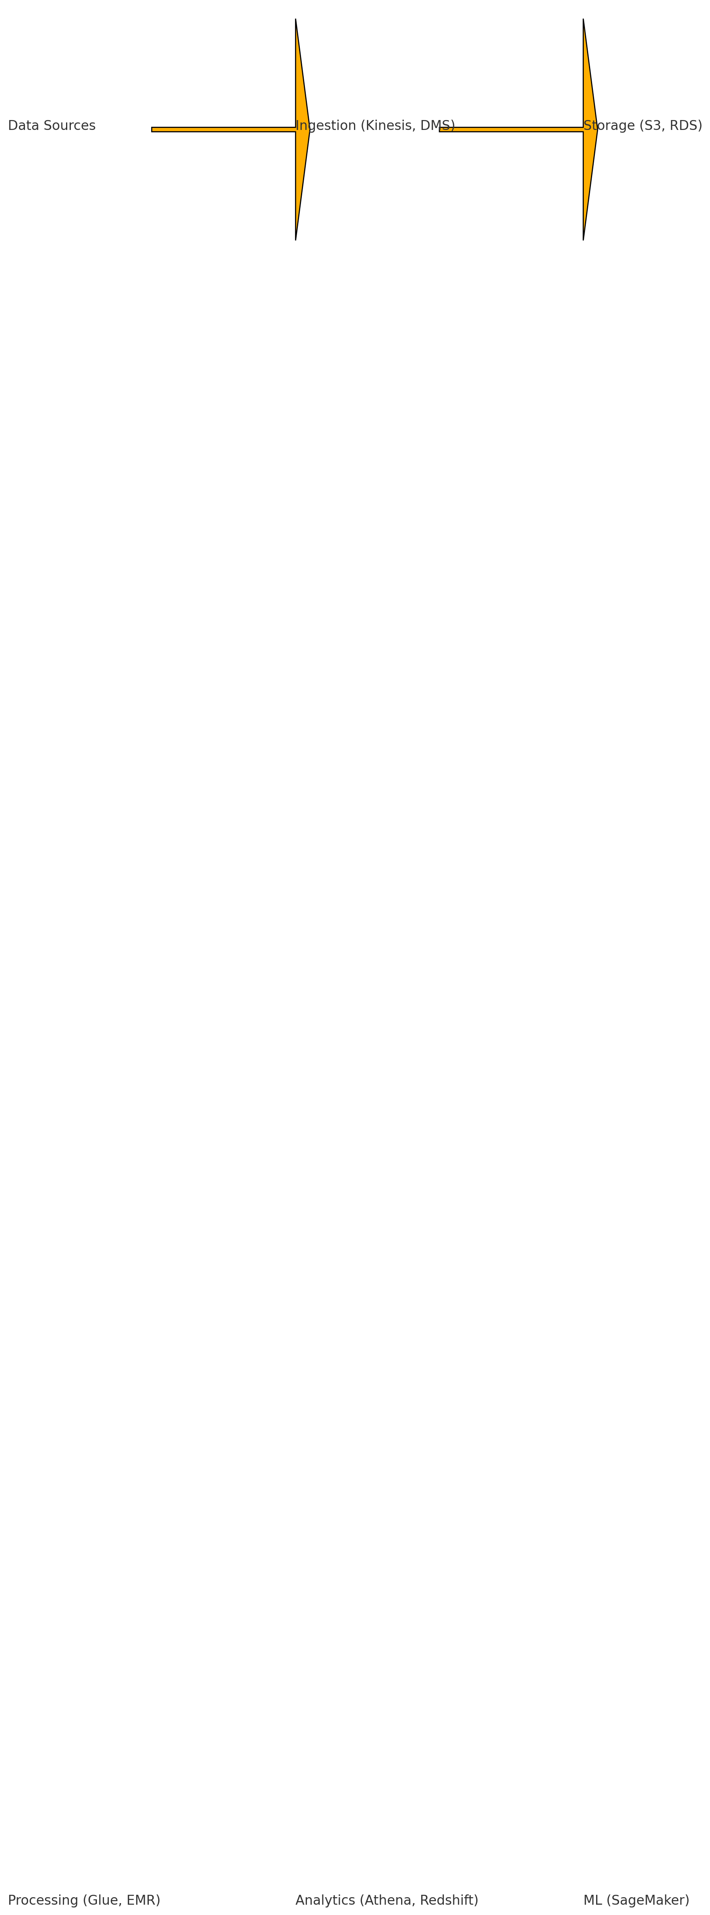
The Big Picture of Data on AWS
AWS provides a complete suite for data collection, storage, processing, and analysis to support modern data-driven applications.
Visual: AWS Big Data Lifecycle showing storage, ETL, analytics, and ML.

Slide 3
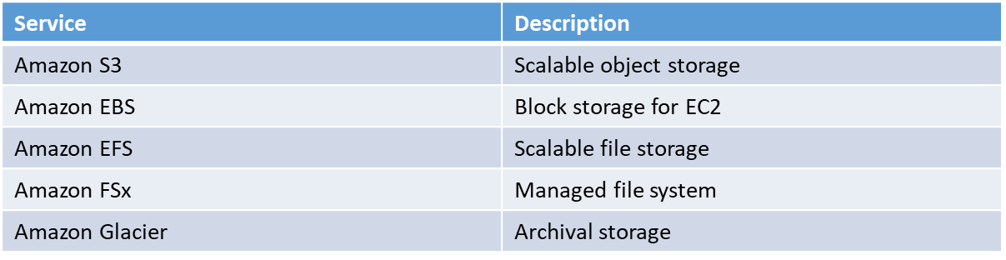
Core AWS Data Storage Services

Slide 4
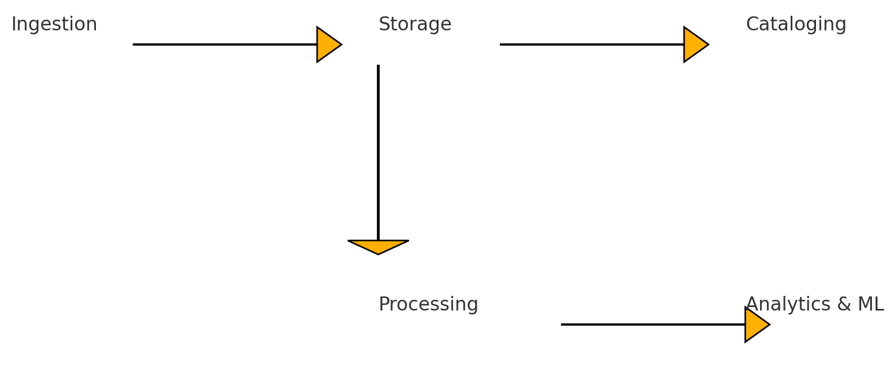
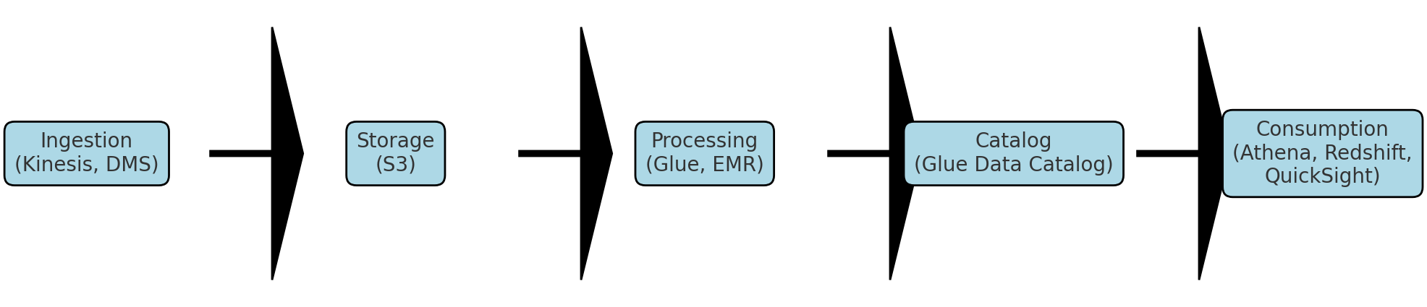
Data Lake Architecture on AWS

Slide 5
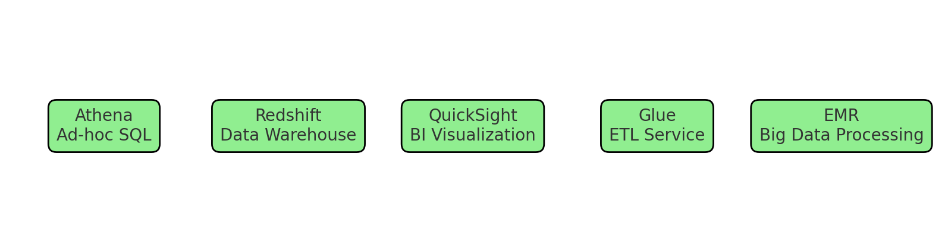
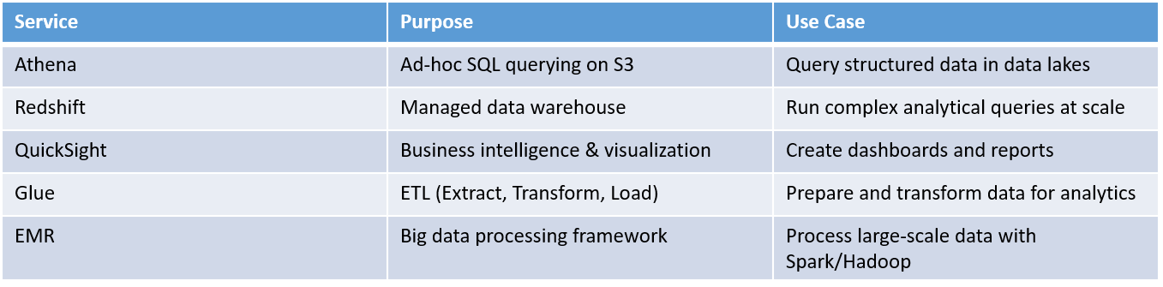
Analytics Services Overview

Slide 6
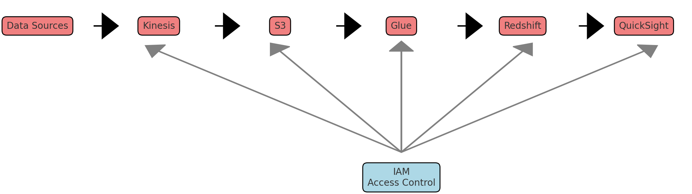
Example Analytics Architecture
Kinesis → S3 → Glue → Redshift → QuickSight with IAM for access control

Slide 7
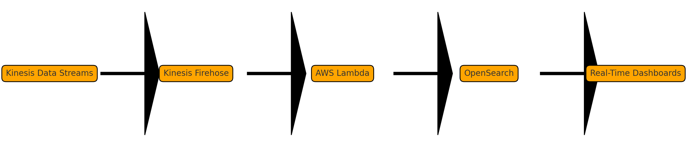
Streaming & Real-Time Analytics
Streaming flow with Amazon Kinesis Data Streams, Firehose, Lambda, and OpenSearch for near real-time dashboards

Slide 8
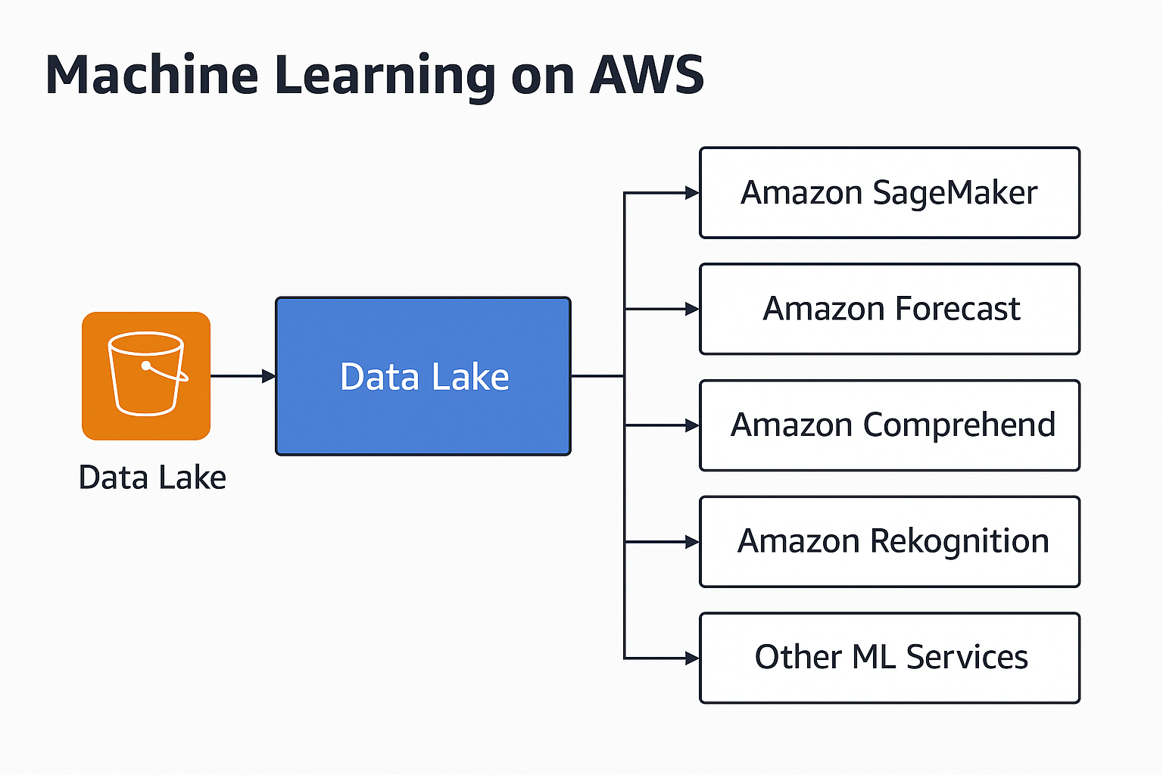
Machine Learning on AWS
SageMaker, Forecast, Comprehend, Rekognition, and other services connected to data lake or S3

Slide 9
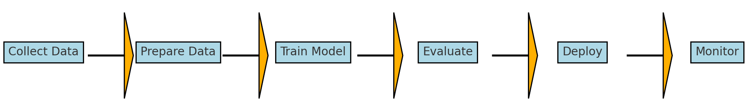
Typical ML Workflow
Step 1: Collect & Label Data
Step 2: Prepare & Clean
Step 3: Choose Algorithm
Step 4: Train Model
Step 5: Evaluate
Step 6: Deploy
Step 7: Monitor & Retrain

Slide 10
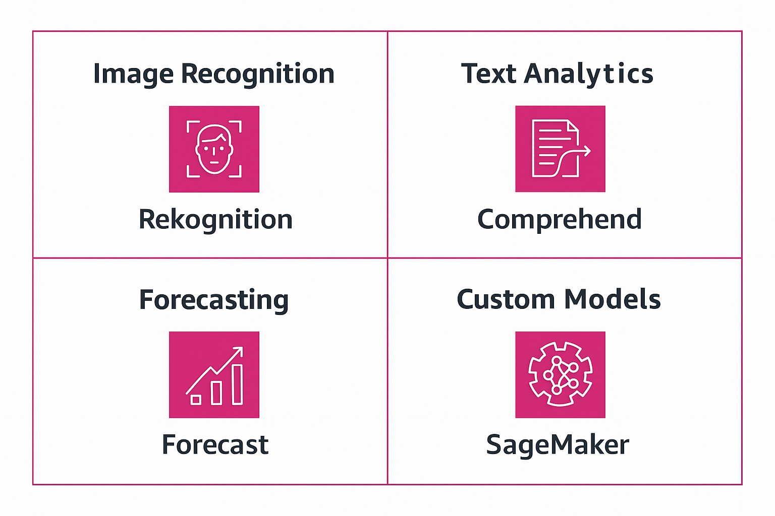
ML Use Cases & Services

Slide 11
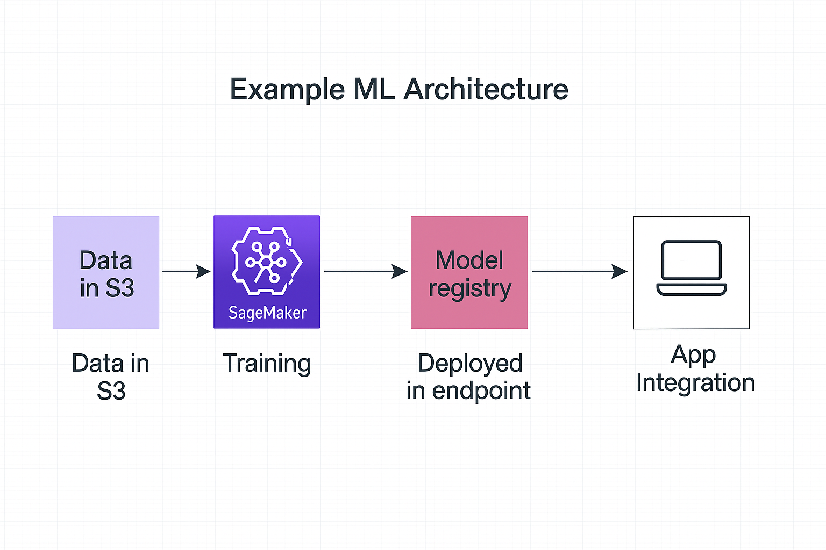
ML Architecture on AWS

Slide 12
Data & ML Security Best Practices
Best practices:
- Encrypt data in transit & at rest
- Use IAM roles & policies
- Enable logging with CloudTrail
- Use VPC Endpoints & PrivateLink
- Enable GuardDuty & Macie

Slide 13
Key Takeaways
1. AWS offers integrated tools for data lake, analytics, and ML.
2. Choose services based on workload: batch, real-time, or predictive.
3. Secure data pipelines are essential.
4. Automate and monitor your workflows.

Slide 14
Further Learning & Resources
Resources:
- AWS Data Analytics Learning Path
- AWS ML Specialty Certification
- Labs on SageMaker, Athena, Redshift
- AWS Workshops and Immersion Days

